Slide 1

RedBus Travel Information System (RTIS)
Web Scraping & Data Visualization System
Lakshmi Devi S

Slide 2
Project Agenda
Problem Statement
Project Overview
Tools and Technologies
Data Scrapping
Data Design
Data Visualization
Future Improvements
References
Conclusion

Slide 3
Problem Statement
Travelers struggle to access real-time, consolidated bus data, with information scattered across multiple platforms.
Current systems lack interactive filters and real-time updates, making it difficult to compare routes, pricing, and availability.
As a result, travelers spend excessive time manually searching for bus options, leading to inefficiency and frustration.
There is a clear need for a unified, easy-to-use platform for bus travel planning.

Slide 4
Project Overview
This project addresses the challenges faced by travelers by providing a centralized platform for real-time bus travel information. It scrapes data from RedBus using Selenium, capturing key details like bus schedules, prices, availability, and routes. The data is stored in a structured MySQL database, making it easily accessible for querying.
A user-friendly Streamlit dashboard allows travelers to interactively filter and compare bus options by state, route, and bus type. Additionally, visualizations such as pie charts for seat availability help users make informed decisions quickly, streamlining the travel planning process. give this is in form of list

Slide 5
Tools and Technologies
Selenium: Web scraping and interaction with RedBus.
MySQL: Database for storing structured data.
Python: Core programming language for automation and integration.
Streamlit: Data visualization and interaction.

Slide 6
Selenium
Selenium is a powerful tool for automating web browsers. It provides a suite of tools for web application testing across different browsers and platforms.
Key Features of Selenium:
Browser Automation: Selenium allows you to automate browsers like Chrome, Firefox, Edge, Safari, etc., to perform repetitive web tasks.
Cross-Browser Compatibility: Tests can be run on different browsers to ensure your web app works across all platforms.
Multiple Language Support: Selenium supports various programming languages including Python, Java, C#, JavaScript, and Ruby.
WebElement Interaction: It allows interacting with page elements like buttons, links, forms, dropdowns, and text fields.
Scripting Capabilities: It supports writing complex scripts to simulate real user interactions (e.g., clicking buttons, filling forms).
Parallel Test Execution: Using Selenium Grid, you can execute tests in parallel across multiple machines and browsers, speeding up the testing process.
Screenshot Capabilities: Selenium can take screenshots during automation, useful for visual testing or debugging.
Headless Browser Testing: Selenium can run in "headless" mode (without UI), making it faster for automated tasks in testing or scraping.

Slide 7
Selenium in RTIS
Step 1 : Setup WebDriver and Navigate
Initializes a Selenium WebDriver for Chrome using webdriver.Chrome().
Launches the RedBus homepage (https://www.redbus.in/) for scraping.
Wait for State Elements:
Uses WebDriverWait to wait until States (bus operators) names are fully loaded on the page.

Slide 8
Selenium in RTIS
Step 2 : RTC Interaction and Bus Route Extraction
Clicking RTC(state) Names:
Each RTC name is selected using driver.execute_script to ensure clicks are not blocked by other elements (ElementClickInterceptedException is handled).
After clicking, the routes for each RTC are displayed.
Extract Bus Details:
For each bus route, a new tab is opened to extract detailed bus information (name, type, departure time, etc.).
Data is scraped using CSS selectors for elements like bus name, departure time, price, and available seats.
Insert Data into Database:
The extracted bus details (e.g., price, seats available) are inserted into the MySQL database (redbus table) using SQL queries executed via pymysql.

Slide 9
Selenium in RTIS
Step 3 : Pagination and Error Handling
Handle Pagination:
The code checks for the "Next" button on the page to navigate to the next set of routes.
Uses driver.execute_script to click the "Next" button and wait for new routes to load.
Error Handling:
TimeoutException and WebDriverException are handled to ensure the scraping continues smoothly in case of delays or navigation issues.
Retries clicking on an element if it’s intercepted.
Return to Previous Page:
After processing all routes on one page, the code returns to the main RTC page and refreshes the RTC names list to scrape more routes.

Slide 10

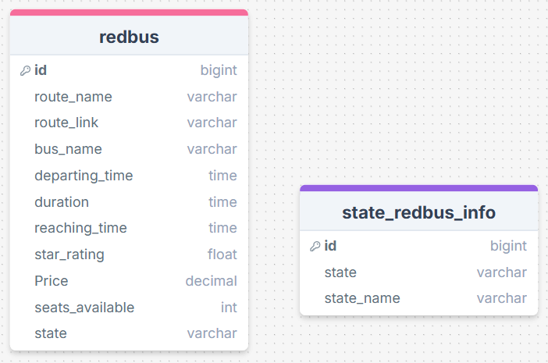
Database Schema
Tools and Tech : Data Design using MySQL

Slide 11
Streamlit
Streamlit is an open-source Python library used to create interactive, data-driven web applications with minimal effort. It allows developers to turn Python scripts into shareable web apps for machine learning and data analysis tasks without needing to know front-end technologies like HTML, CSS, or JavaScript.
Interactive Web Apps: Easily build and deploy web applications directly from Python code.
Real-time Updates: Apps automatically update as users interact with them or as data changes.
Data Visualization: Seamlessly integrates with popular data visualization libraries like Matplotlib, Plotly, and Altair.
Machine Learning Friendly: Ideal for showcasing machine learning models and experiments.

Slide 12
Streamlit in RTIS
1. Streamlit
Creates interactive web interfaces for data filtering and visualization.
Allows users to select filters like State, Route, Bus Name, and Bus Type from dropdowns.
Displays filtered data and visualizations (charts, tables) dynamically.
.

Slide 13
Libraries in RTIS
MySQL Connector (pymysql)
Connects to the MySQL database to fetch travel data.
Executes SQL queries and retrieves results as Python data.
3. Pandas
Handles data manipulation, converting SQL results into structured DataFrames.
Allows formatting of data like time conversion (e.g., departing_time, reaching_time).
4. Plotly
Creates interactive pie charts for visualizing seat availability across bus names.
Displays the chart within the Streamlit interface.
5. Datetime
Manages time formatting to display departing_time and reaching_time in HH:MM:SS format
.

Slide 14
Future Improvement
Enhanced UI: Interactive filters, responsive design.
Data Optimization: Real-time data, improved query performance.
Better Visualizations: Advanced charts, route maps.
API Integration: Real-time updates, external data sources.
Export & Reporting: CSV/Excel export, custom reports.

Slide 15
References
Books:
"Selenium Testing Tools Cookbook" by Unmesh Gundecha
"Mastering Selenium WebDriver" by Mark Collin
Streamlit for Data Science" by Tyler Richards
Hands-On Data Science with Streamlit" by John O'Hara
Official Website Links:
https://www.selenium.dev/documentation/en/
https://docs.streamlit.io/

Slide 16
Conclusion
The RedBus Travel Information System is a dynamic and user-friendly application designed to streamline the process of accessing interstate bus travel data. By leveraging Selenium for web scraping and Streamlit for interactive data visualization, the system offers users the ability to explore bus routes, schedules, availability, and pricing information in real time.
In conclusion, the system simplifies the process of finding relevant bus travel information and has the potential for further expansion to accommodate additional features

